Slide 1
Active Directory
An Quick Overview

Slide 2
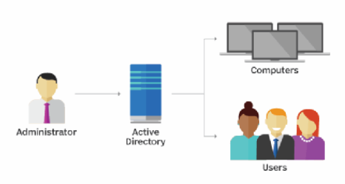
Active Directory
Active Directory:
Defines a hierarchical structure that stores information about objects on the network.
Objects typically include shared resources such as users, groups, computers, domains, organizational units, and security policies.
A directory service, such as Active Directory Domain Services (AD DS), provides the methods for storing directory data and making this data available to network users and administrators.

Slide 3
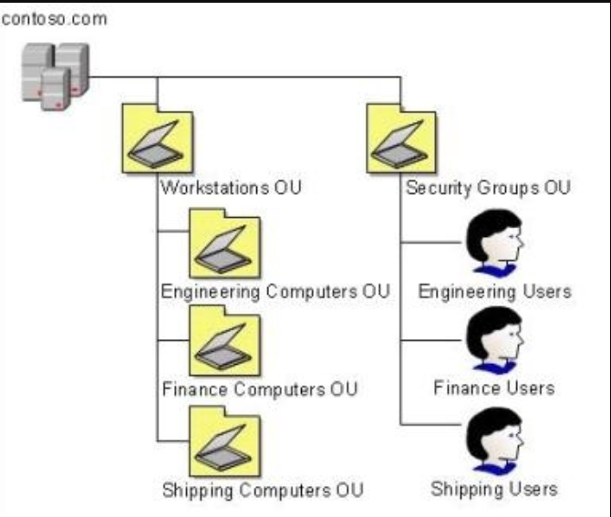
OU – Organizational Units

Slide 4
ADDS Groups
Users
Computers
Users and their usernames and passwords may be added to ADDS groups.
Company comuters have a unique identifier and may also be added to groups.

Slide 5
GPO – Group Policy Objects and types
Local Group Policy
Non-local Group Policy aka Group Policy in AD
Starter Group Policy
Applies to the local computer and to any users who log on to that computer.
Applies to all users or computers when they are associated with a specific domain or organizational unit.
Templates for future group policies.

Slide 6
Active Directory Domain Controllers
On-premise
Azure
- Contains all AD data related to their domain – there may be more than one copy of the controller within the same domain.
Hybrid
Controller files are stored on company-owned hard drives.
There are no controllers to manage. It is is the cloud and managed by Microsoft.
A mix of on-premise and Azure. This provides redundancy.

